Slide 1
To Classify user will return order or accept oreder

Slide 2
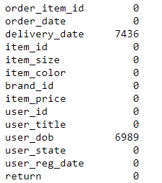
About Data
Shape of data is 79945,14
Missing values
Given attributes

Slide 3
New Attributes created
No of days taken ,age on network ,user age , as we see the data is of year 2015,2016 so we taken an ideal date of 1-jan-2017 to find age on network and age of user
No of days taken to deliver – in this we order date is subtracted from delivery date so in data there few rows don’t have delivery, so we do groupby and taken median for no of days with respect to item id
Age on network – we subtract user registration date from 1-jan-2017
Age of user – we subtract user dob-1-jan-2017
days_user_taken_to_get_register-diff btw user to get register from his DOB
User birth _month- in which user Dob come to check seasonality
User_month_order – in which month user do order of year

Slide 4
Steps we do
1) we check shape of data ,type of attributes ,missing value
2) created new attributes ,missing value treatment ,outlier treatment, categorical to numerical conversion, standard scaling ,EDA
3) All preprocessing
4)Apply diff Ml models ,Dl models
Conclusion Out of diff ml,dl models one ml model perform better getting 68 % accuracy on training and 62 % on in sample data set

Slide 5
Further Work Can be done to improve model performance
Create New Kpi ,
Again retune model
Try with diff Models
Do more EDA

Slide 6
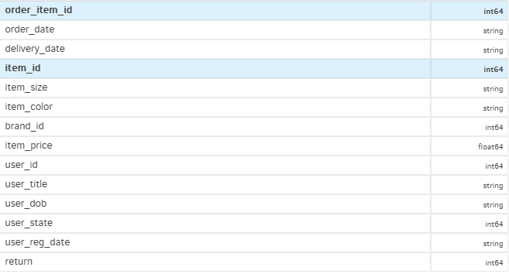
Attributes given

Slide 7
EDA Results
On 27-06-2016 more orders done ,29-06-2016 second most order done
On 3-07-2016 most orders delivered,04-07-2016 most order delivered
Most selling item id is 1415,1532,22 have highest sale item
Size large ,xl,m have highest value count
The most selling color are black,blue,brown
The most selling brand id is 3,1,5
Most users buy 39.9 rs item,49.9,59.9
As We seen that approx. 95 % females do online shopping
Most value count dates are 21-11-1900 @note 21-11-1900 is kind of some default value which is provided in data
Most users have state of 1010,1008,1002 which have high value count
Max users are having registration date is 17-02-2015
Approx 54% return have values 0
No of days taken to deliver is 4, 30 ,3 having high value count then
27144 users are those who are greater than 1.5 years time
We seen that data provided have users 27 to 84 age period which is having 50 to 55 age have max users

Slide 8
EDA Outcome for return=1
On an average upto 12 to 13 days taken for delivery they will get max return =1
Those users which are greater than 1.5 years registered there return =1
Users whose age is 51,49,53 they have return =1
User state 1010,1008,1002 they have return =1
Approx 90 % female do return=1
Max price range of 50 to 100 item have value return =1
Brand id of 3,1,11 have max return =1
Black,blue,brown are colors of item max having value return =1
Item size max have return =1 is l,xl,m
Those item which have max return =1 having item id is 100,1532,1607

Slide 9
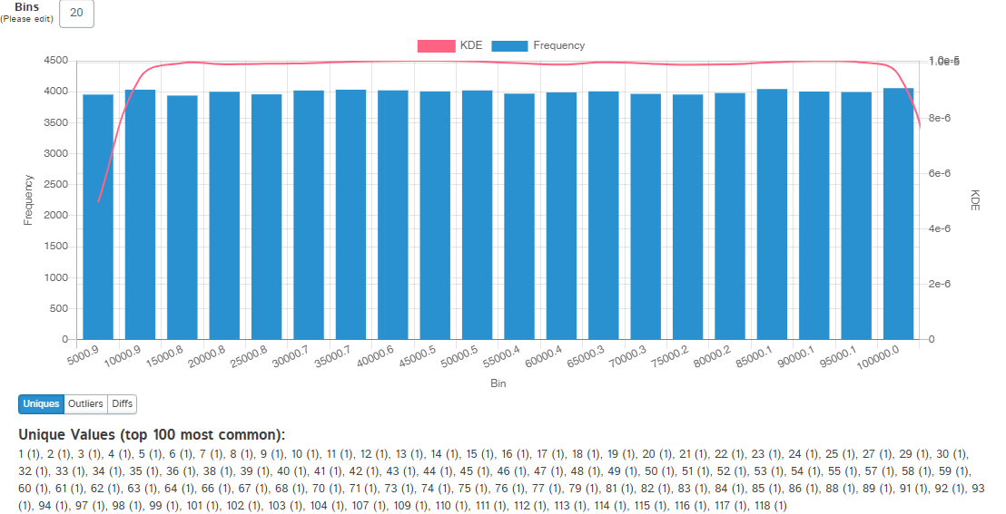
Order item id

Slide 10
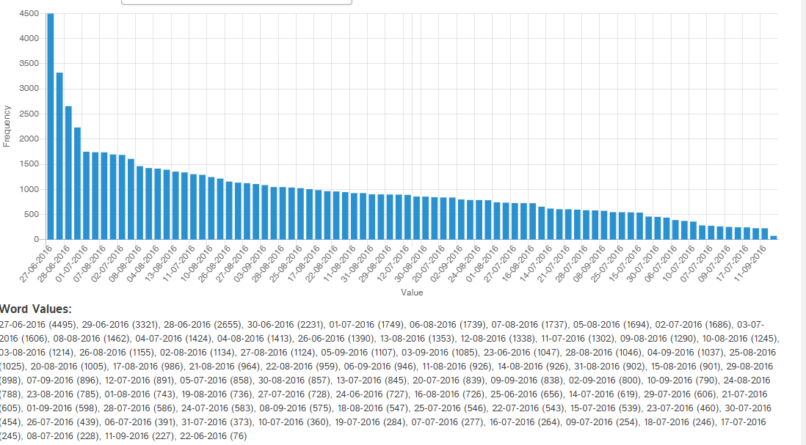
Order_date
On 27-06-2016 more orders done ,29-06-2016 second most order done

Slide 11
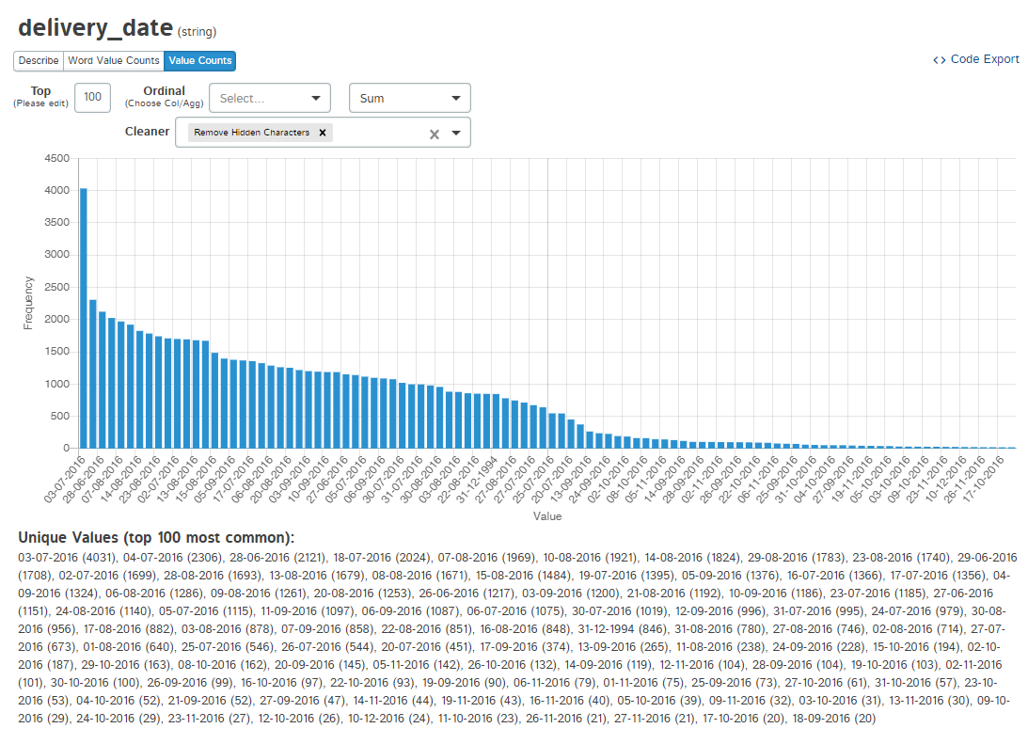
Delivery date
On 3-07-2016 most orders delivered,04-07-2016 most order delivered

Slide 12
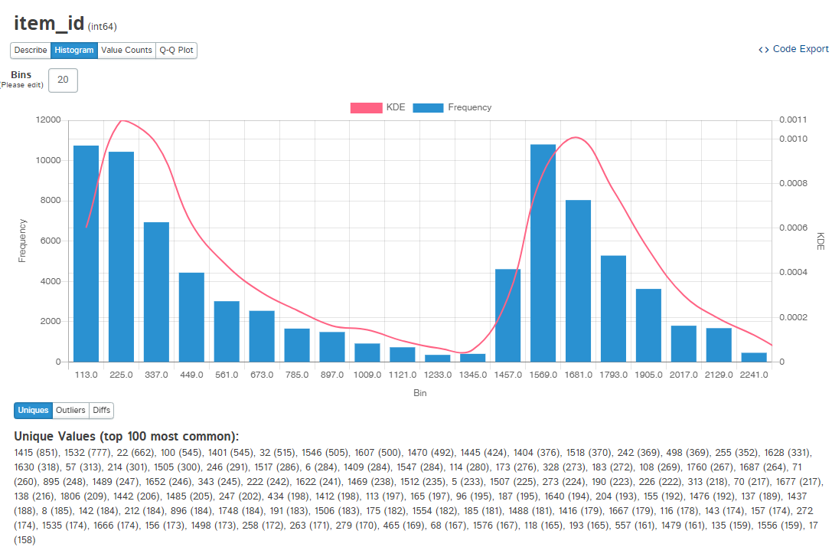
Item ID
Most selling item id is 1415,1532,22 have highest sale item

Slide 13
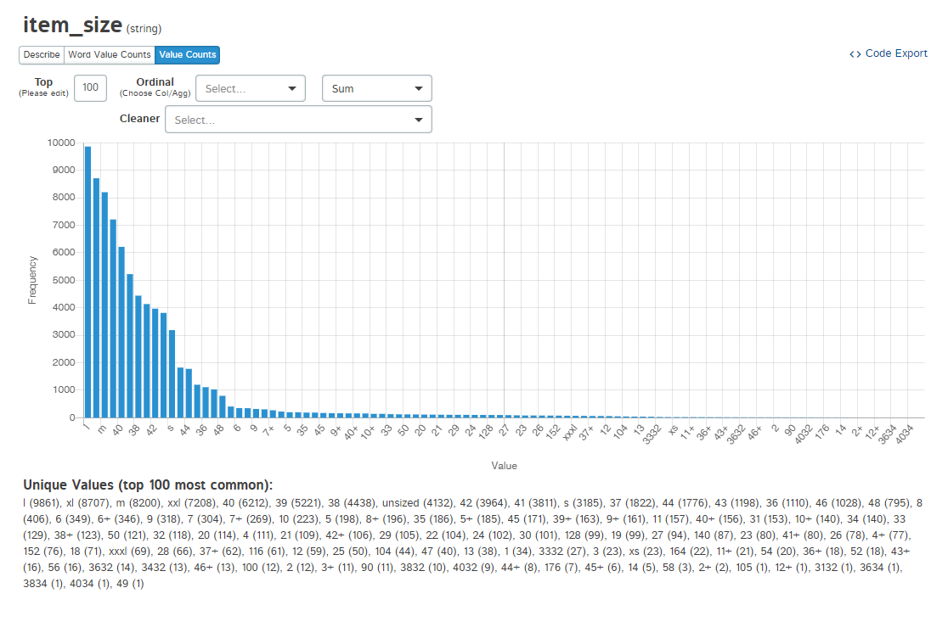
Item size
Size large ,xl,m have highest value count

Slide 14
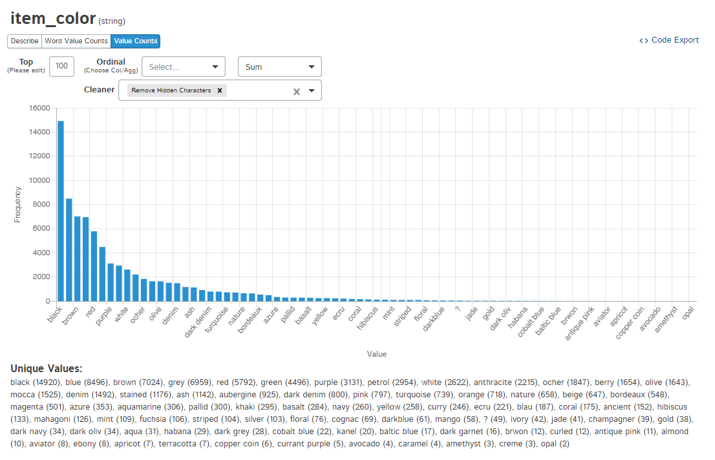
Item color
The most selling color are black,blue,brown

Slide 15
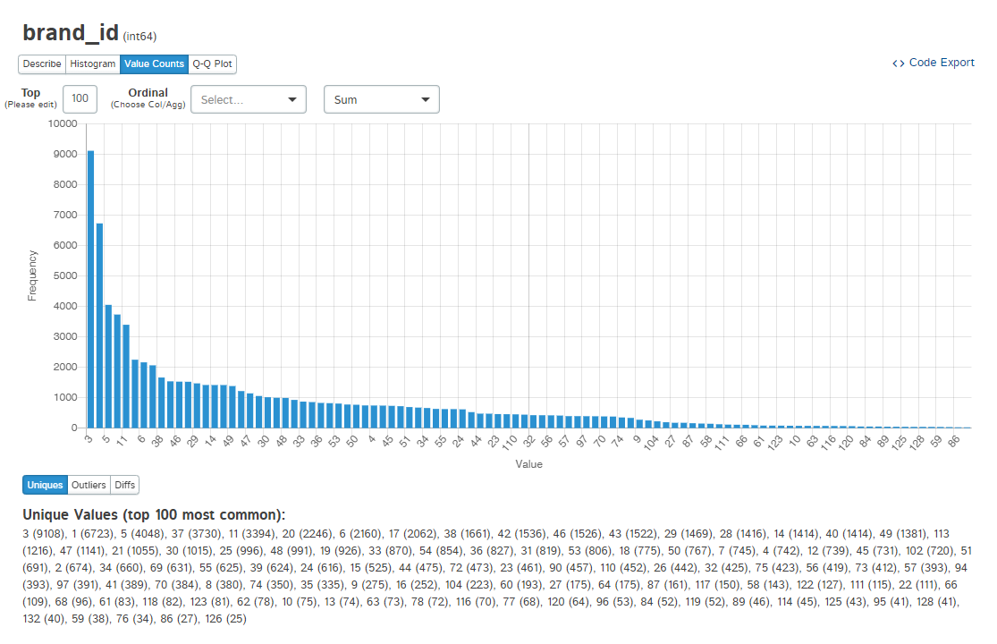
Brand id
The most selling brand id is 3,1,5

Slide 16
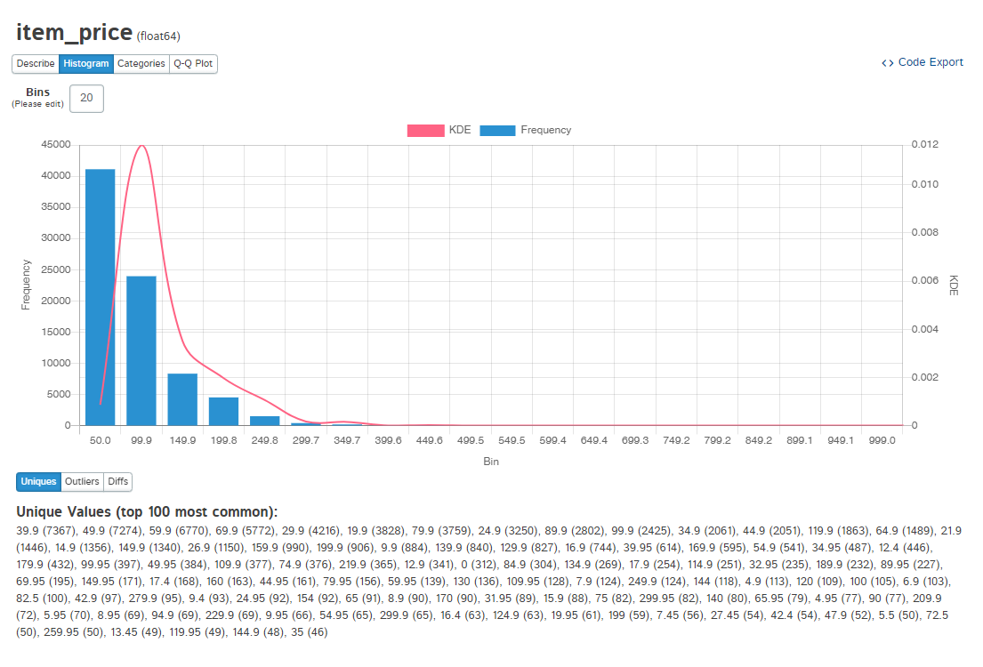
Item_price
Most users buy 39.9 rs item,49.9,59.9

Slide 17
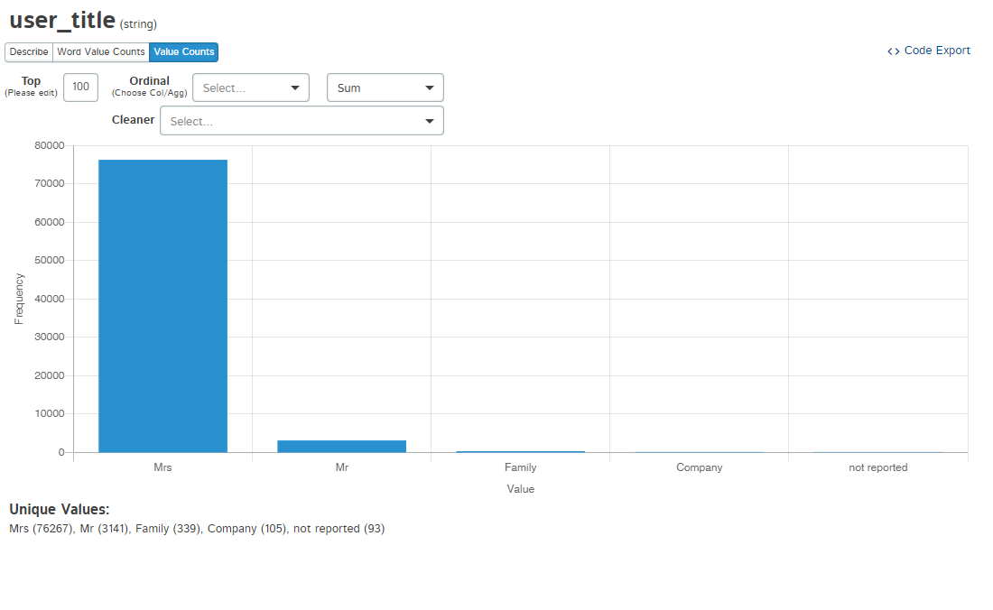
User_title
As We seen that approx. 95 % females do online shopping

Slide 18
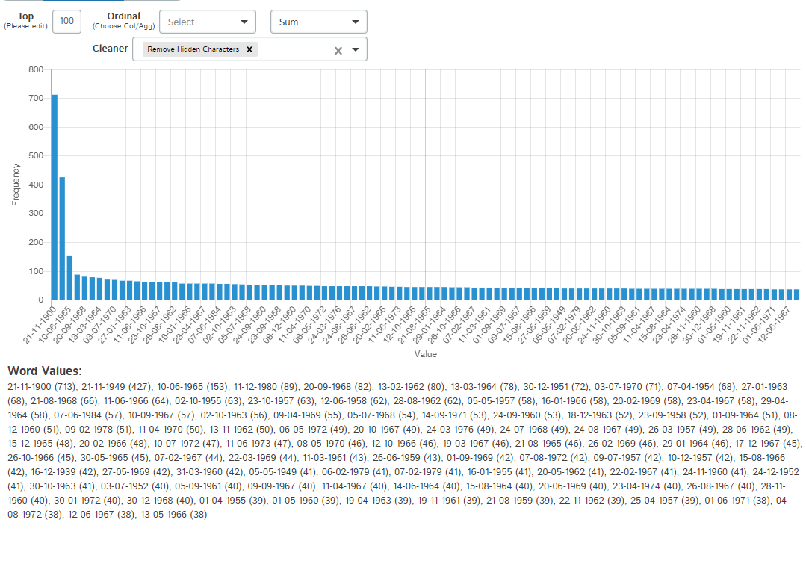
User_dob
Most value count dates are 21-11-1900
@note 21-11-1900 is kind of some default value which is provided in data

Slide 19
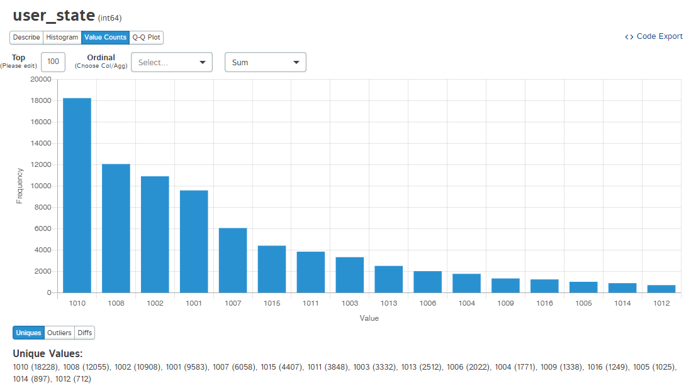
User_state
Most users have state of 1010,1008,1002

Slide 20
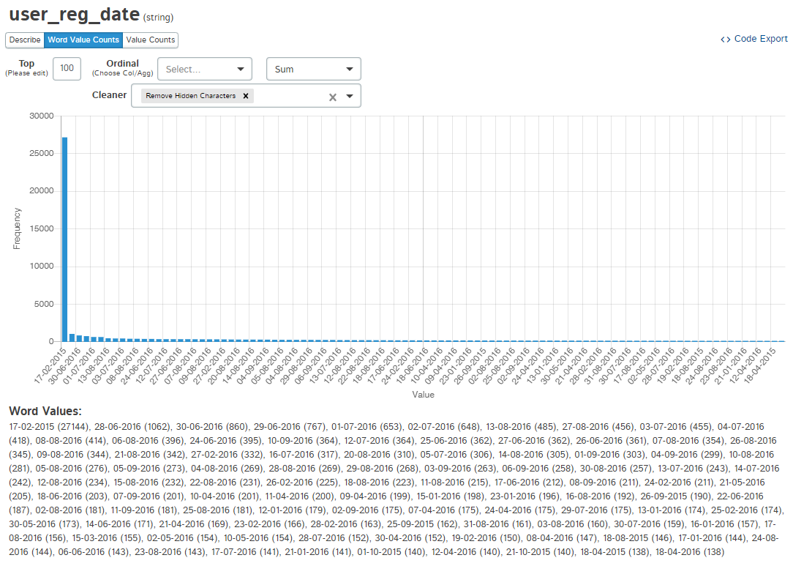
User_registration_date
Max users are having registration date is 17-02-2015

Slide 21
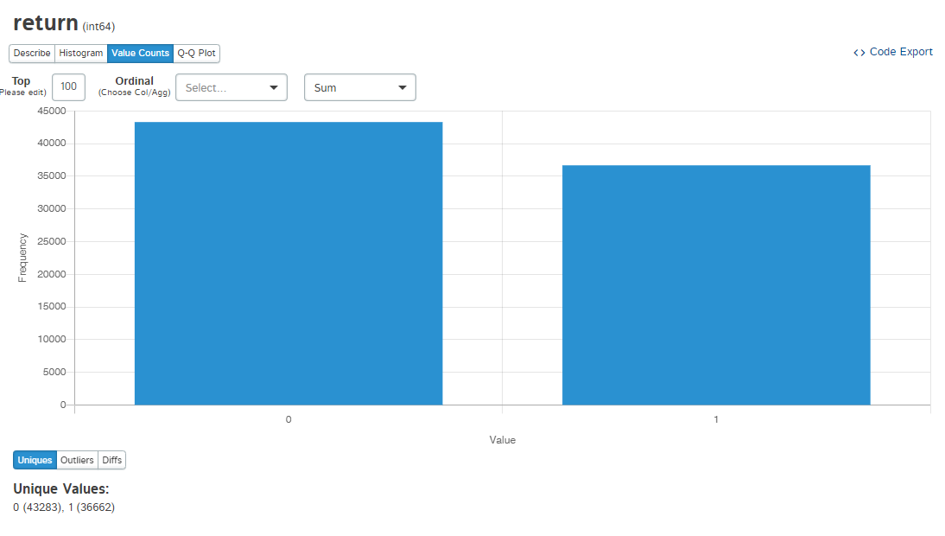
Return
Approx 54% return have values 0

Slide 22
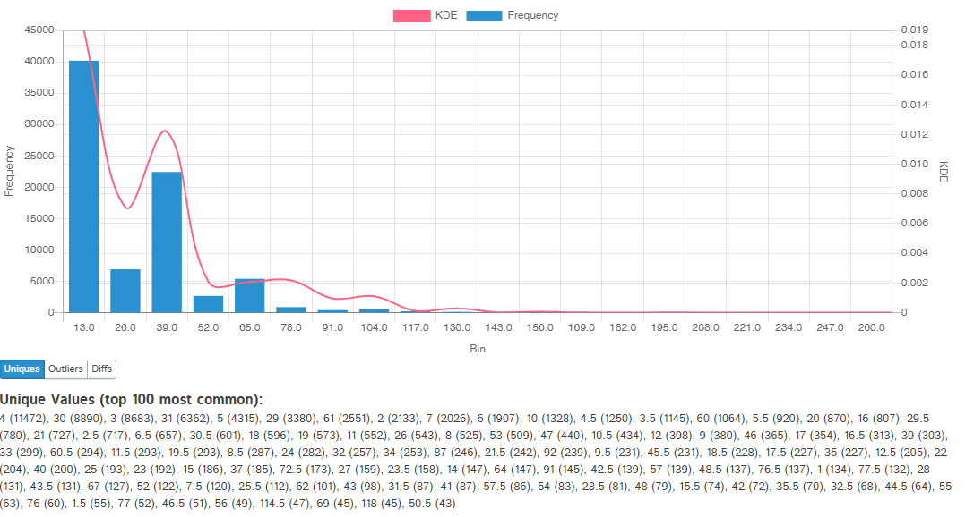
No of days taken to deliver
No of days taken to deliver is 4 having high value count then 30 ,3

Slide 23
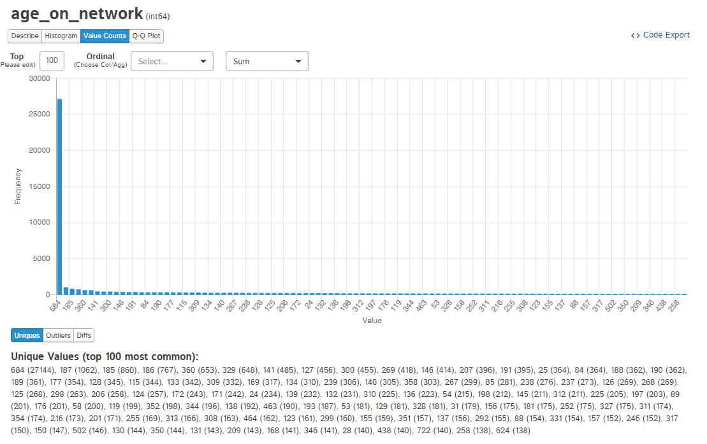
Age on network
27144 users are those who are greater than 1.5 years time

Slide 24
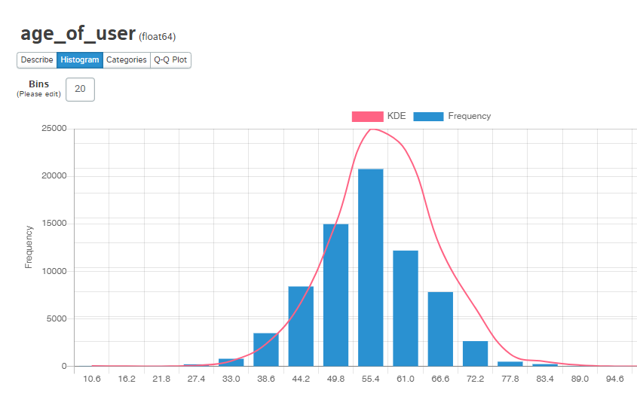
Age of users
We seen that data provided have users 27 to 84 age period which is having 50 to 55 age have max users

Slide 25
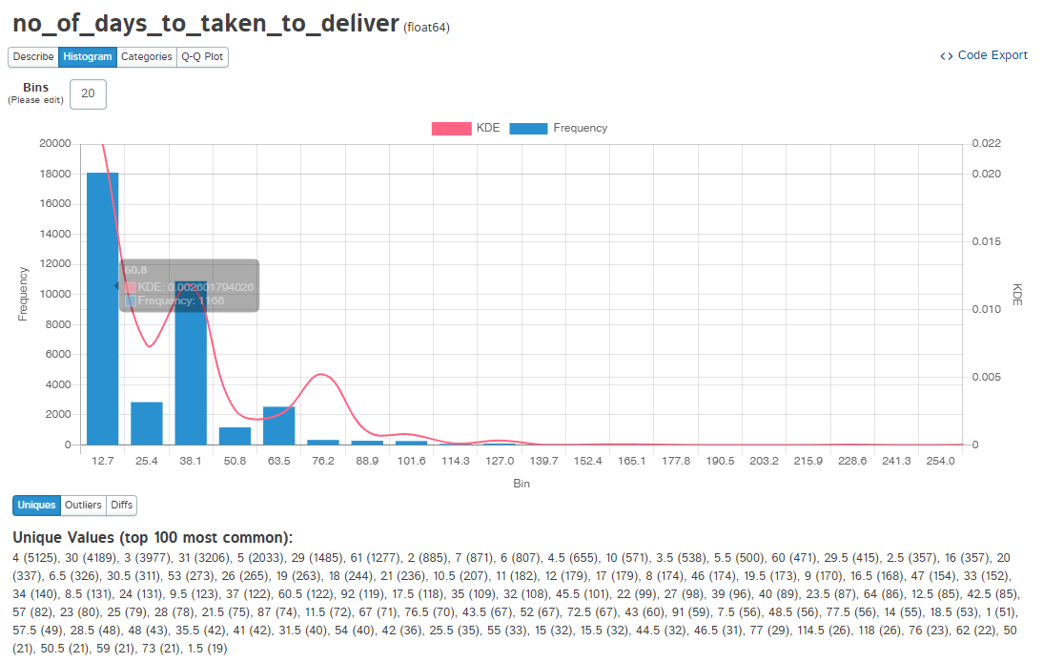
Reasons for order getting return=1 no of days taken to deliver
On an average upto 12 to 13 days taken for delivery they will get max return =1

Slide 26
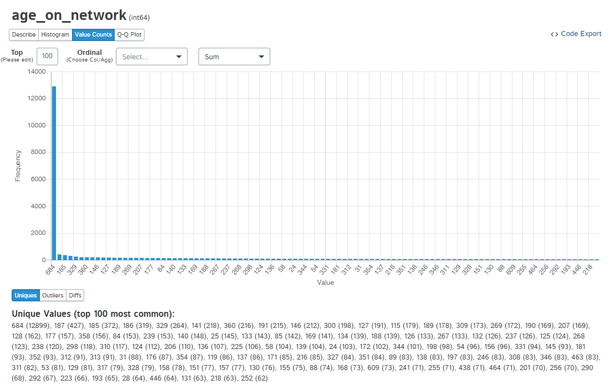
Age on network
Those users which are greater than 1.5 years registered there return =1

Slide 27
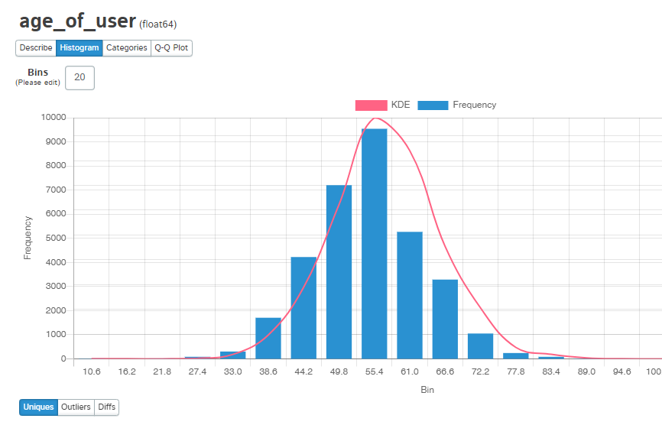
Age of user
Users whose age is 51,49,53 they have return =1

Slide 28
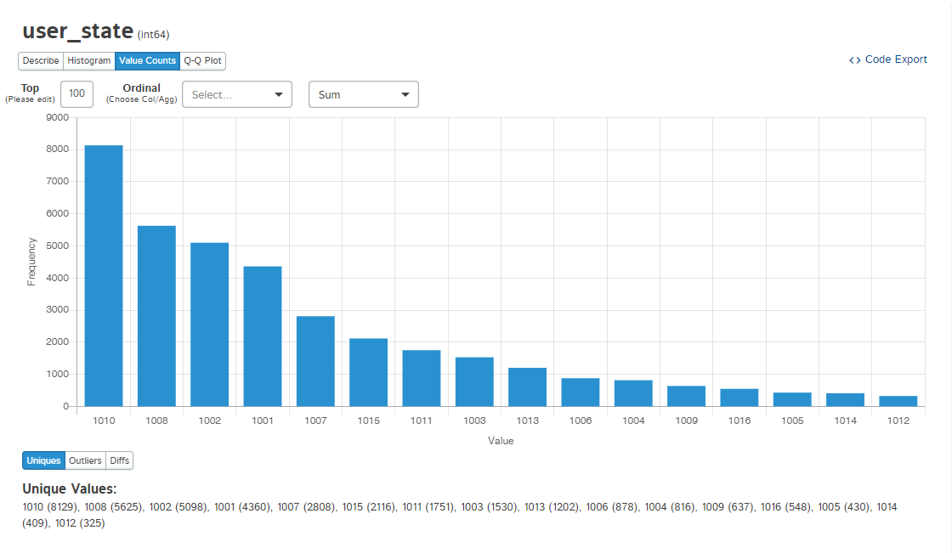
User state
User state 1010,1008,1002 they have return =1

Slide 29
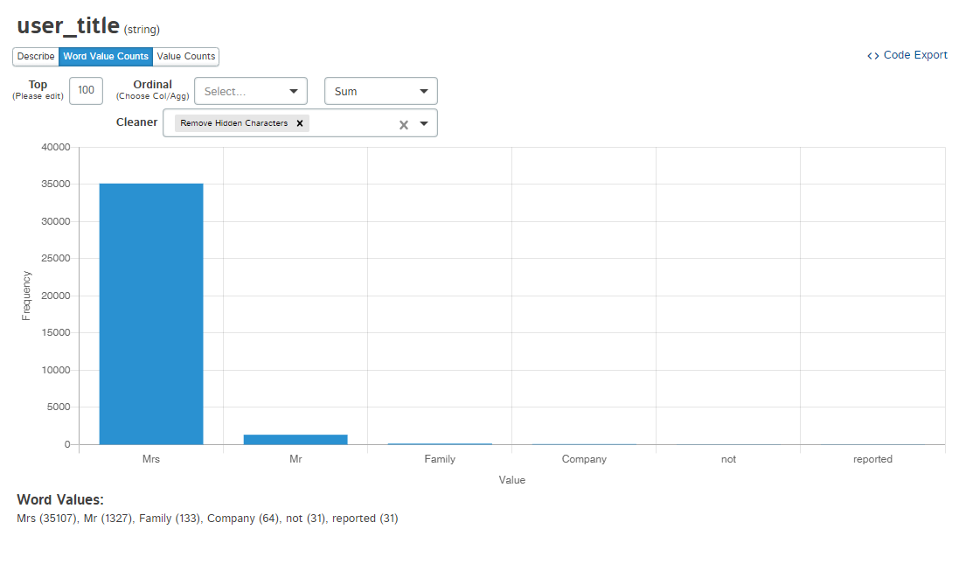
User title
Approx 90 % female do return=1

Slide 30
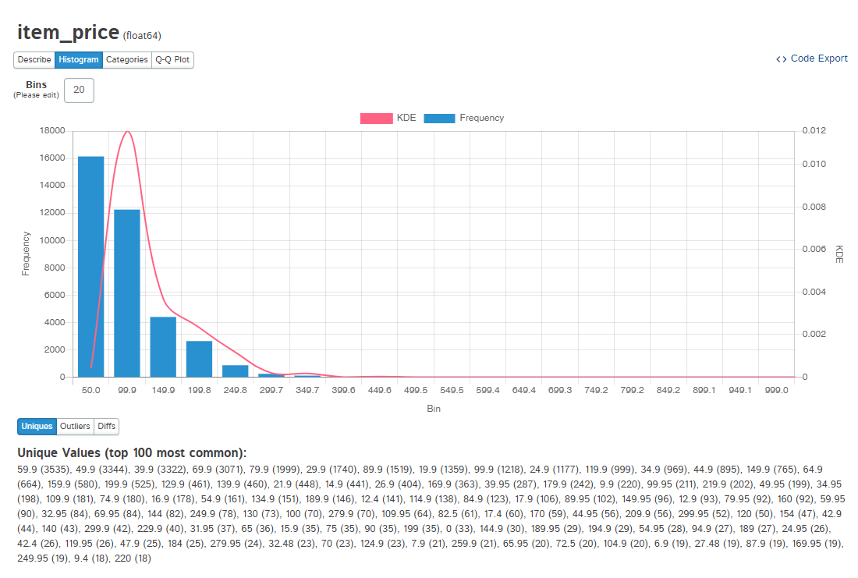
Item price
Max price range of 50 to 100 item have value return =1

Slide 31
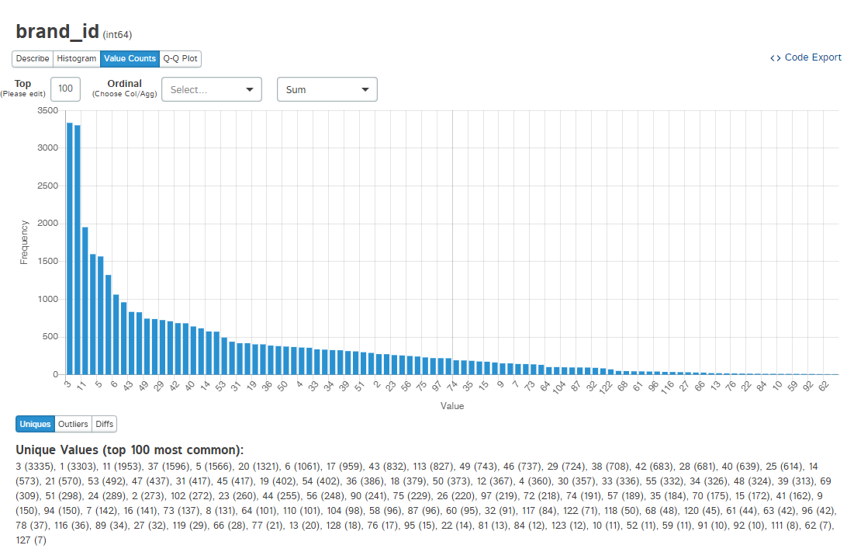
Brand id
Barnd id of 3,1,11 have max return =1

Slide 32
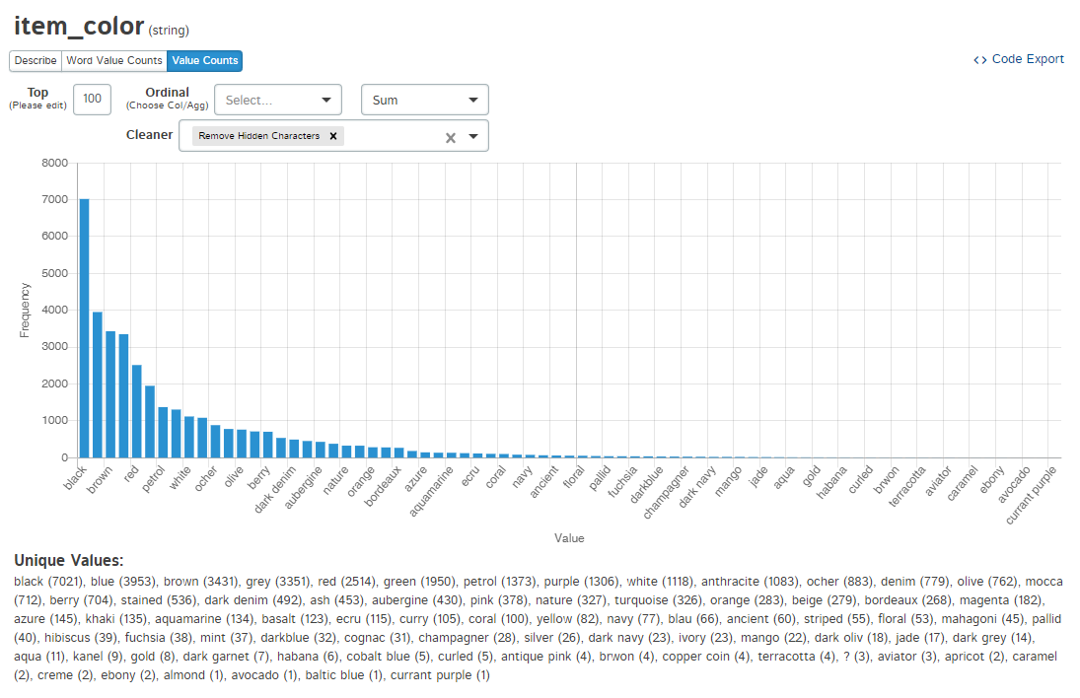
Item color
Black,blue,brown are colors of item max having value return =1

Slide 33
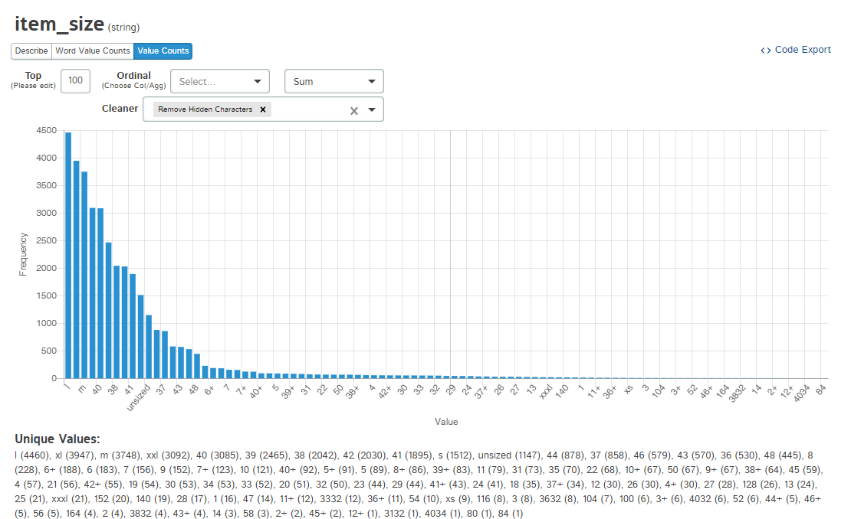
Item size
Item size max have return =1 is l,xl,m

Slide 34
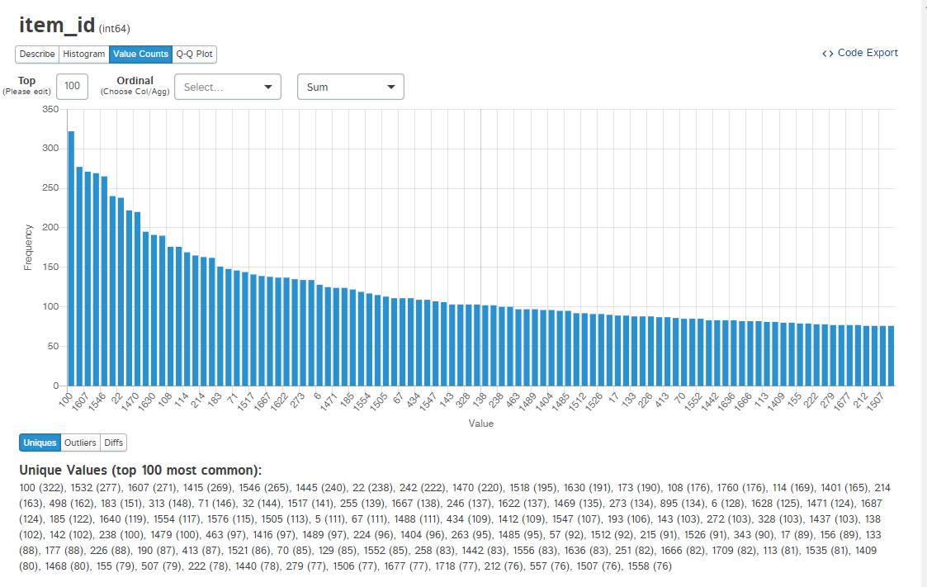
Item id
Those item which have max return =1 having item id is 100,1532,1607

Slide 35
The END

